Slide 1
Recovery System

Slide 2
Failure Classification
Transaction failure :
Logical errors: transaction cannot complete due to some internal error condition
System errors: the database system must terminate an active transaction due to an error condition (e.g., deadlock)
System crash: a power failure or other hardware or software failure causes the system to crash.
Fail-stop assumption: non-volatile storage contents are assumed to not be corrupted by system crash
Database systems have numerous integrity checks to prevent corruption of disk data
Disk failure: a head crash or similar disk failure destroys all or part of disk storage
Destruction is assumed to be detectable: disk drives use checksums to detect failures

Slide 3
Recovery Algorithms
Recovery algorithms are techniques to ensure database consistency and transaction atomicity and durability despite failures
Recovery algorithms have two parts
Actions taken during normal transaction processing to ensure enough information exists to recover from failures
Actions taken after a failure to recover the database contents to a state that ensures atomicity, consistency and durability

Slide 4
Storage Structure
Volatile storage:
does not survive system crashes
examples: main memory, cache memory
Non-volatile storage:
survives system crashes
examples: disk, tape, flash memory, non-volatile (battery backed up) RAM
Stable storage:
a mythical form of storage that survives all failures
approximated by maintaining multiple copies on distinct nonvolatile media

Slide 5
Recovery Methods
To ensure atomicity despite failures, we first output information describing the modifications to stable storage without modifying the database itself.
We study two approaches:
log-based recovery, and
shadow-paging
We assume (initially) that transactions run serially, that is, one after the other.

Slide 6
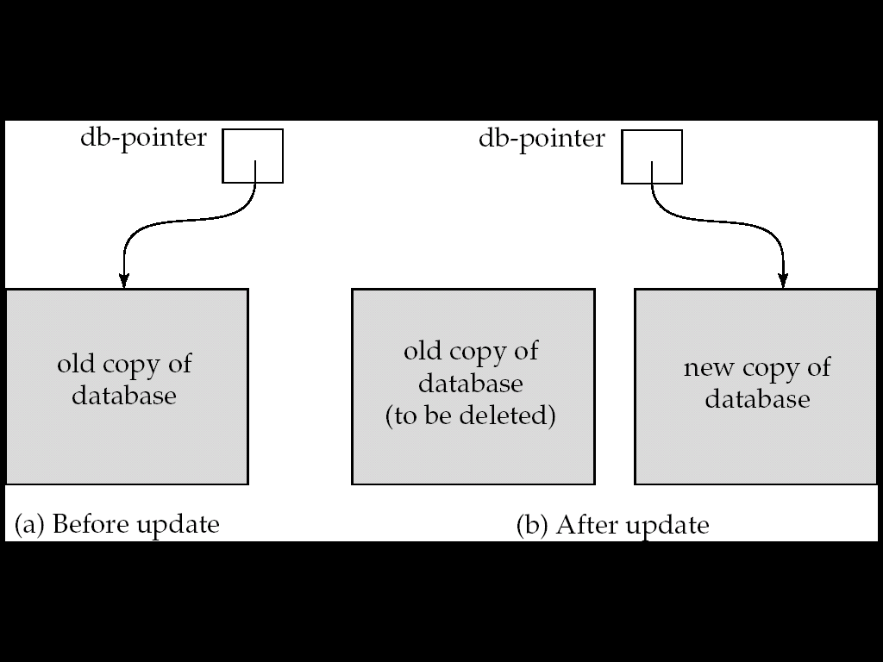
Shadow Copies and Shadow Paging

Slide 7
Log-Based Recovery
A log is kept on stable storage.
The log is a sequence of log records, and maintains a record of update activities on the database.
When transaction T_{i} starts, it registers itself by writing a <T_{i} start>log record
Before T_{i} executes write(X), a log record <T_{i}, X, V₁, V₂> is written, where V₁ is the value of X before the write, and V₂ is the value to be written to X.
Log record notes that T_{i} has performed a write on data item X_{j} X_{j} had value V₁ before the write, and will have value V₂ after the write.
When T_{i} finishes it last statement, the log record <T_{i} commit> is written.
We assume for now that log records are written directly to stable storage (that is, they are not buffered)
Two approaches using logs
Deferred database modification
Immediate database modification

Slide 8
Deferred Database Modification
The deferred database modification scheme records all modifications to the log, but defers all the writes to after partial commit.
Assume that transactions execute serially
Transaction starts by writing <T_{i} start> record to log.
A write(X) operation results in a log record <T_{i}, X, V> being written, where V is the new value for X
Note: old value is not needed for this scheme
The write is not performed on X at this time, but is deferred.
When T_{i} partially commits, <T_{i} commit> is written to the log
Finally, the log records are read and used to actually execute the previously deferred writes.

Slide 9
Deferred Database Modification (Cont.)
During recovery after a crash, a transaction needs to be redone if and only if both <T_{i} start> and<T_{i} commit> are there in the log.
Redoing a transaction T_{i} ( redoT_{i}) sets the value of all data items updated by the transaction to the new values.
Crashes can occur while
the transaction is executing the original updates, or
while recovery action is being taken
example transactions T₀ and T₁ (T₀ executes before T₁):
T₀: read (A) T₁ : read (C)
A: - A - 50 C:- C- 100
Write (A) write (C)
read (B)
B:- B + 50
write (B)

Slide 10
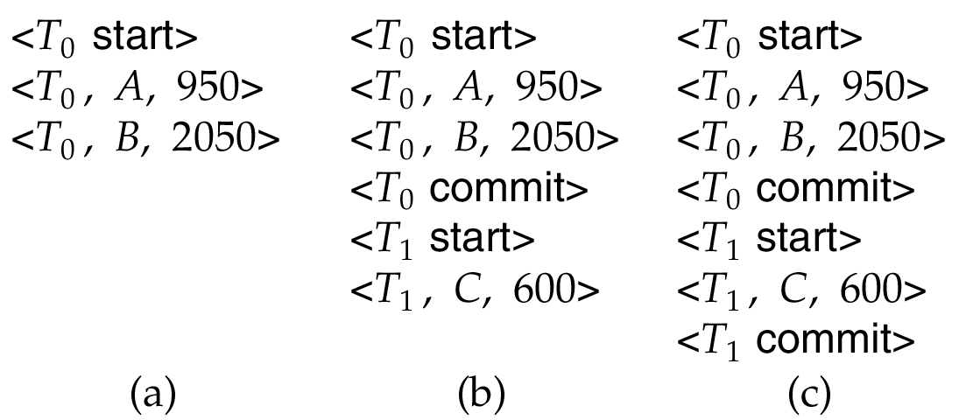
Deferred Database Modification (Cont.)
Below we show the log as it appears at three instances of time.
If log on stable storage at time of crash is as in case:
(a) No redo actions need to be taken
(b) redo(T₀) must be performed since <T₀ commit> is present
(c) redo(T₀) must be performed followed by redo(T₁) since
<T₀ commit> and <T_{i} commit> are present

Slide 11
Immediate Database Modification
The immediate database modification scheme allows database updates of an uncommitted transaction to be made as the writes are issued
since undoing may be needed, update logs must have both old value and new value
Update log record must be written before database item is written
We assume that the log record is output directly to stable storage
Can be extended to postpone log record output, so long as prior to execution of an output(B) operation for a data block B, all log records corresponding to items B must be flushed to stable storage
Output of updated blocks can take place at any time before or after transaction commit
Order in which blocks are output can be different from the order in which they are written.

Slide 12
Immediate Database Modification Example
Log Write Output
<T₀ start>
<T₀, A, 1000, 950>
T_{o}, B, 2000, 2050
A = 950
B = 2050
<T₀ commit>
<T₁ start>
<T₁, C, 700, 600>
C = 600
B_{B}, B_{C}
<T₁ commit>
B_{A}
Note: B_{X} denotes block containing X.
x₁

Slide 13
Immediate Database Modification (Cont.)
Recovery procedure has two operations instead of one:
undo(T_{i}) restores the value of all data items updated by T_{i} to their old values, going backwards from the last log record for T_{i}
redo(T_{i}) sets the value of all data items updated by T_{i} to the new values, going forward from the first log record for T_{i}
Both operations must be idempotent
That is, even if the operation is executed multiple times the effect is the same as if it is executed once
Needed since operations may get re-executed during recovery
When recovering after failure:
Transaction T_{i} needs to be undone if the log contains the record <T_{i} start>, but does not contain the record <T_{i} commit>.
Transaction T_{i} needs to be redone if the log contains both the record <T_{i} start> and the record <T_{i} commit>.
Undo operations are performed first, then redo operations.

Slide 14
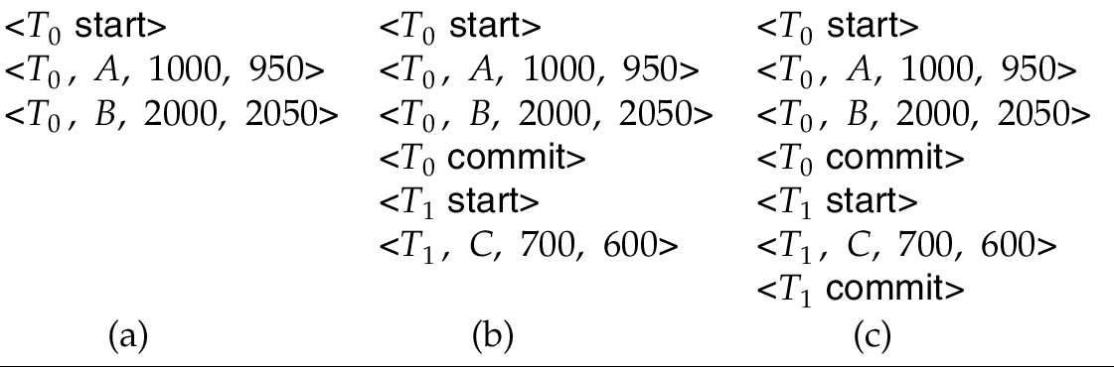
Immediate DB Modification Recovery Example
Below we show the log as it appears at three instances of time.
Recovery actions in each case above are:
(a) undo (T₀): B is restored to 2000 and A to 1000.
(b) undo (T₁) and redo (T₀): C is restored to 700, and then A and B are
set to 950 and 2050 respectively.
(c) redo (T₀) and redo (T₁): A and B are set to 950 and 2050
respectively. Then C is set to 600

Slide 15
Checkpoints
Problems in recovery procedure as discussed earlier :
searching the entire log is time-consuming
we might unnecessarily redo transactions which have already
output their updates to the database.
Streamline recovery procedure by periodically performing checkpointing
Output all log records currently residing in main memory onto stable storage.
Output all modified buffer blocks to the disk.
Write a log record < checkpoint> onto stable storage.

Slide 16
Checkpoints (Cont.)
During recovery we need to consider only the most recent transaction T_{i} that started before the checkpoint, and transactions that started after T_{i}.
Scan backwards from end of log to find the most recent <checkpoint> record
Continue scanning backwards till a record <T_{i} start> is found.
Need only consider the part of log following above start record. Earlier part of log can be ignored during recovery, and can be erased whenever desired.
For all transactions (starting from T_{i} or later) with no <T_{i} commit>, execute undo(T_{i}). (Done only in case of immediate modification.)
Scanning forward in the log, for all transactions starting from T_{i} or later with a <T_{i} commit>, execute redo(T_{i}).

Slide 17
Example of Checkpoints
T_{c}
T_{f}
T₁ can be ignored (updates already output to disk due to checkpoint)
T₂ and T₃ redone.
T₄ undone
T₁
T₂
T₃
T₄
checkpoint
system failure

